Slide 1


Slide 2
Agenda
Logistic Regression – Intuition
Sigmoid and Logid function
Decision Boundary
Cost Function of Logistic Regression
Binary vs Multi-Class Classification
Evaluation of Logistic Regression
Applications
Solving for overfitting using regularization
Food for thought
Notes:
In London

Slide 3
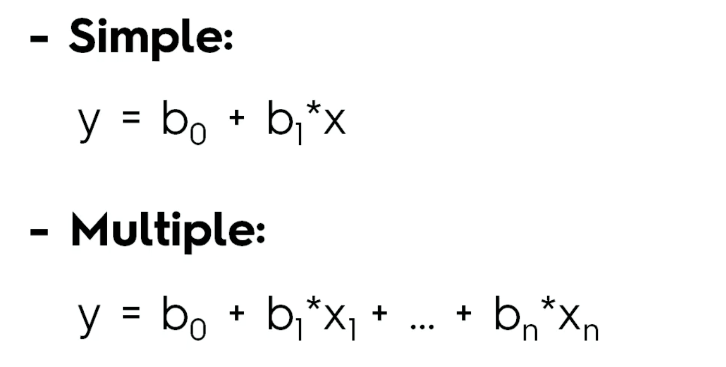
Linear Regression
Notes:
In London

Slide 4
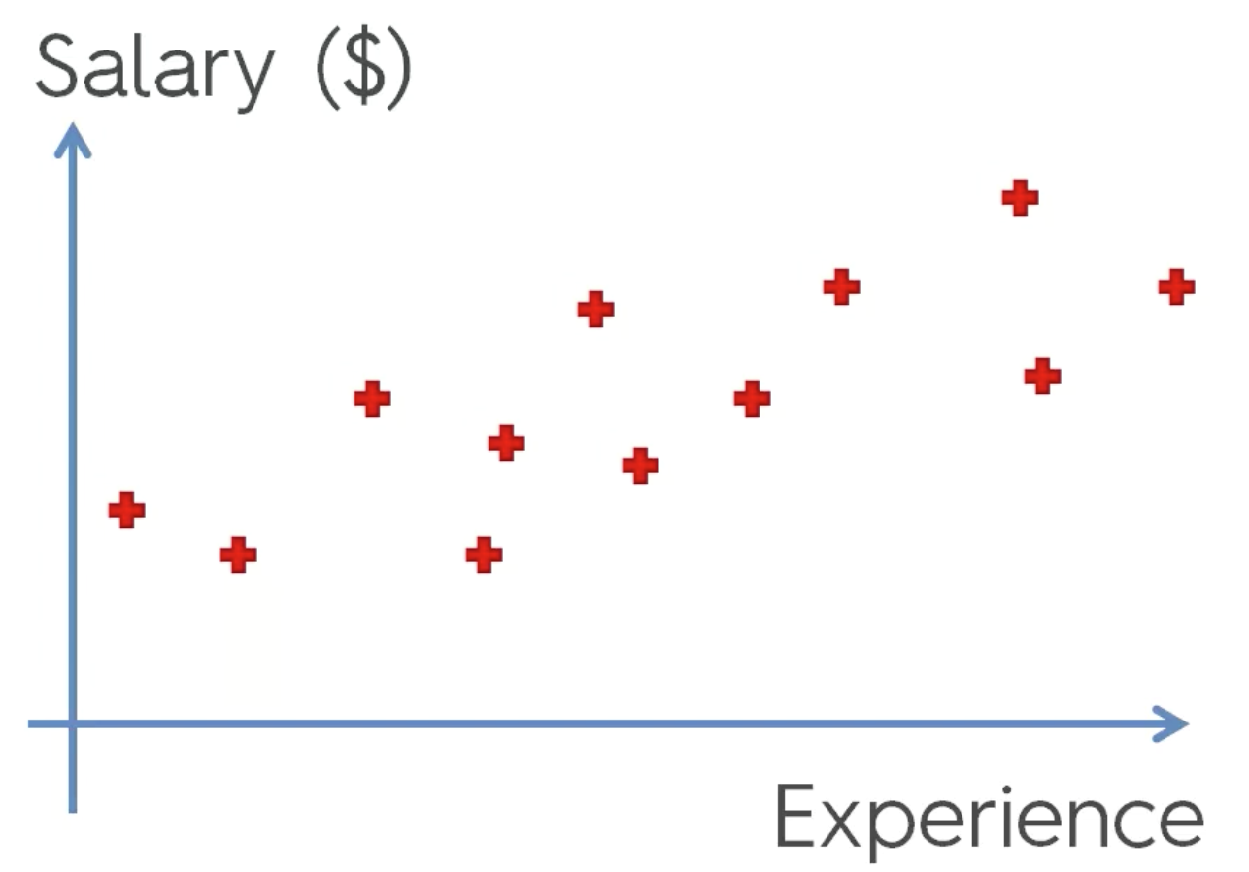
We know this ..
Notes:
In London

Slide 5
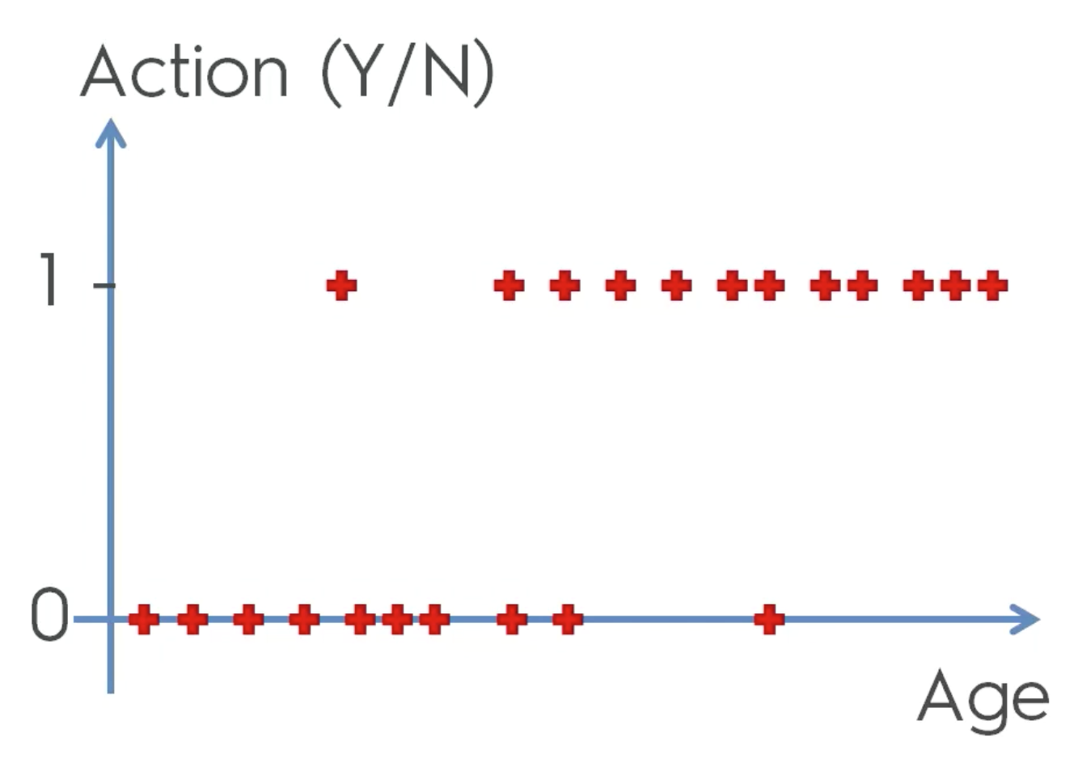

This is new ..
Notes:
In London

Slide 6
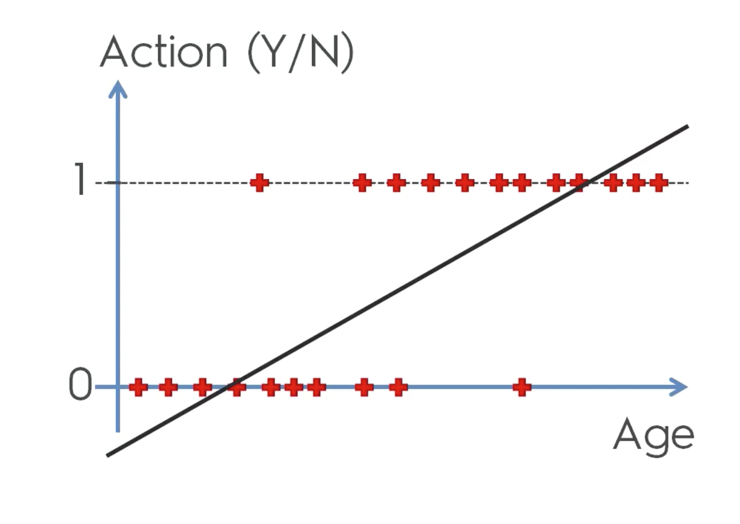
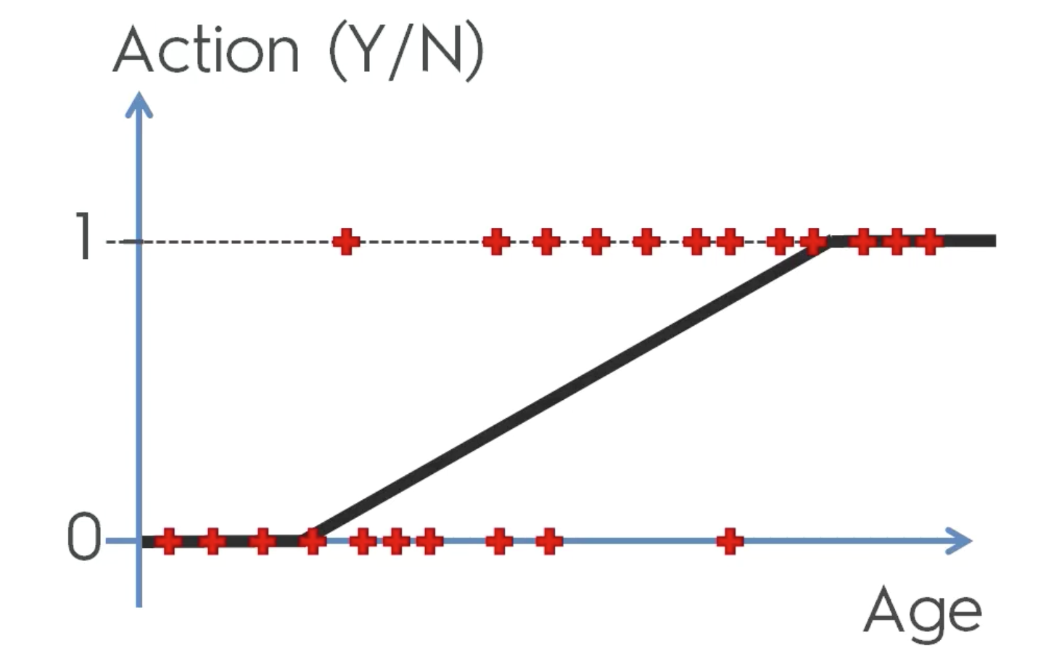
Logistic Regression
Notes:
In London

Slide 7
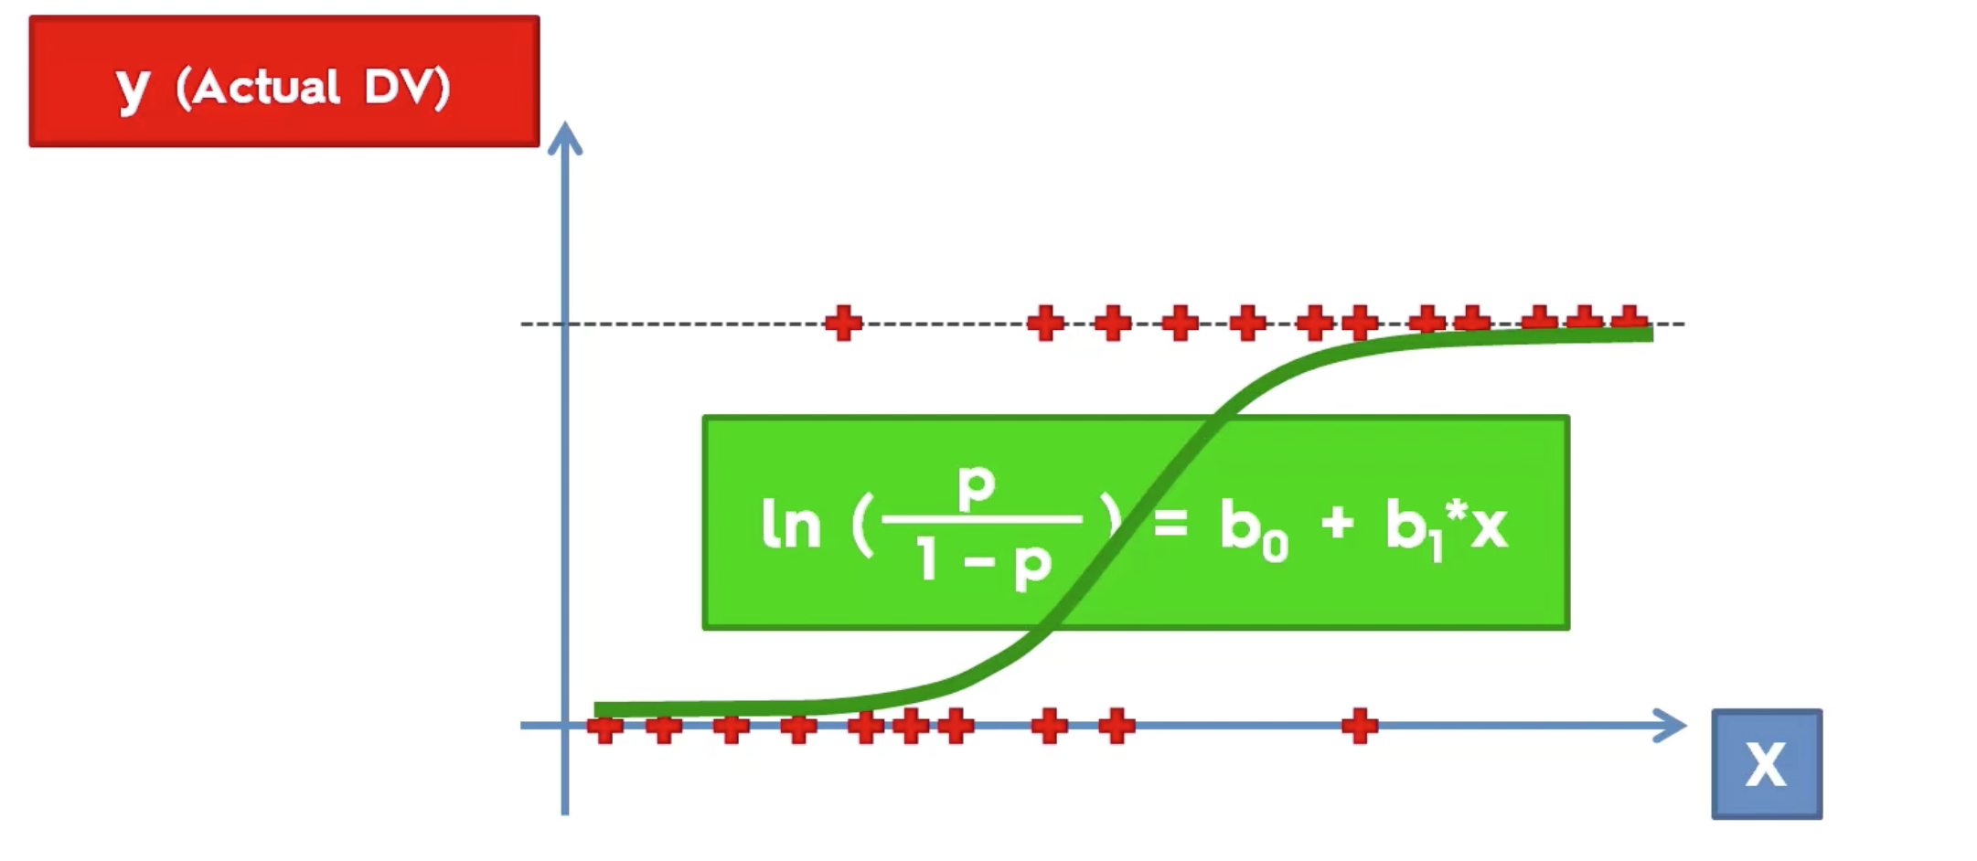
Logistic Regression
Notes:
In London

Slide 8
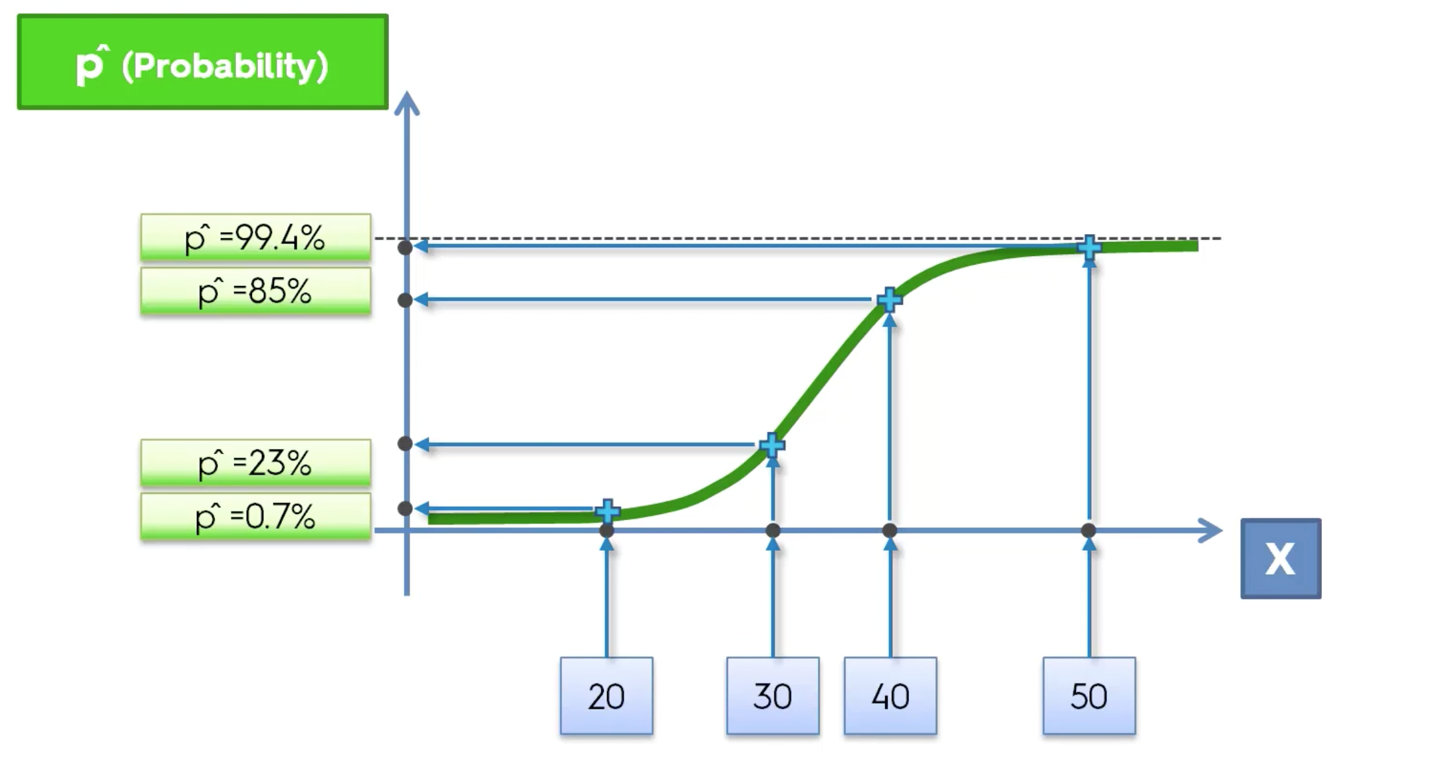
Logistic Regression
Notes:
In London

Slide 9
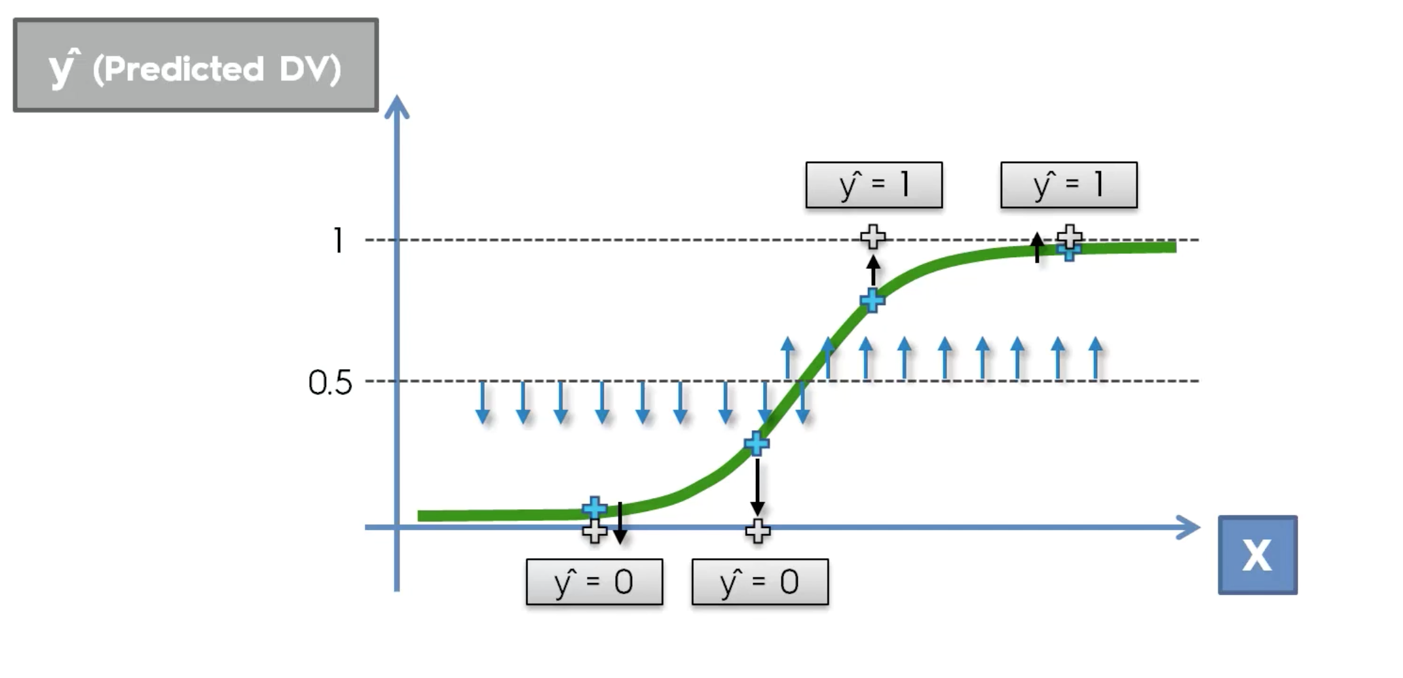
Logistic Regression
Notes:
In London

Slide 10
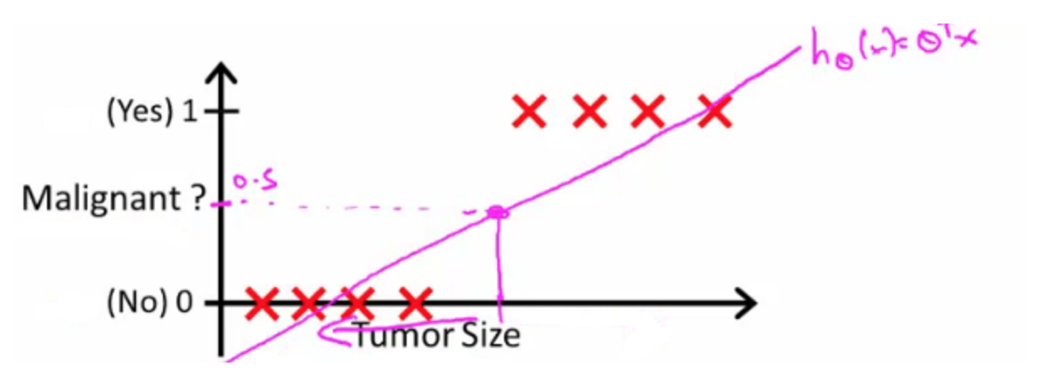
Decision Boundary
Notes:
This can be represented as a linear regression problem or not?
This is a classification problem with a decision boundary of .5
If X is a feature vector with x₀ = 1 (as always) and x₁ = tumourSize
h_{θ}(x) = 0.7
Tells a patient they have a 70% chance of a tumor being malignant
z=0,e0=1⇒g(z)=1/2z→∞,e−∞→0⇒g(z)=1z→−∞,e∞→∞⇒g(z)=0

Slide 11
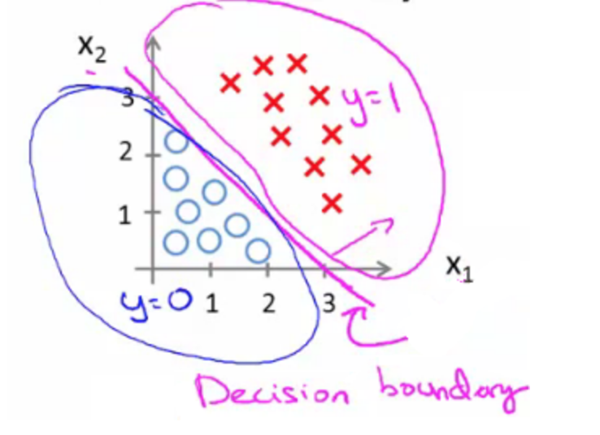
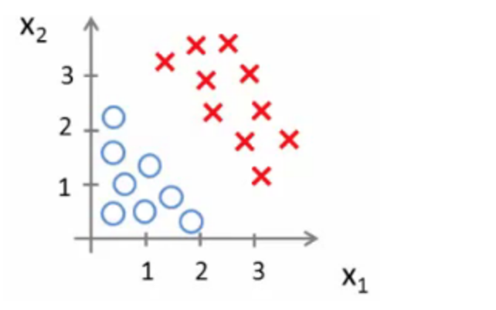
Decision Boundary contd..
h_{θ}(x) = g(θ₀ + θ₁x₁ + θ₂x₂)
Notes:
The decision boundary is a property of the hypothesis means we can create the boundary with the hypothesis and parameters without any data
Later, we use the data to determine the parameter values

Slide 12
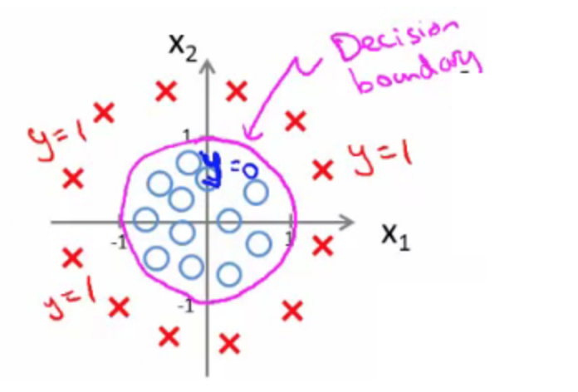
Non linear decision boundary
h_{θ}(x) = g(θ₀ + θ₁x₁+ θ₃x₁² + θ₄x₂²)
Say θ^{T} was [-1,0,0,1,1] then we say;
Predict that "y = 1" if
-1 + x₁² + x₂² >= 0 or
x₁² + x₂² >= 1
Notes:
The decision boundary is a property of the hypothesis means we can create the boundary with the hypothesis and parameters without any data
Later, we use the data to determine the parameter values

Slide 13
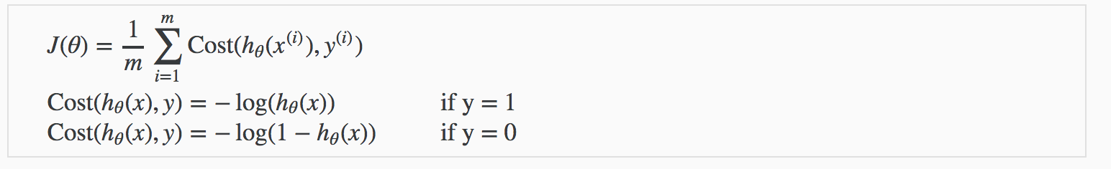
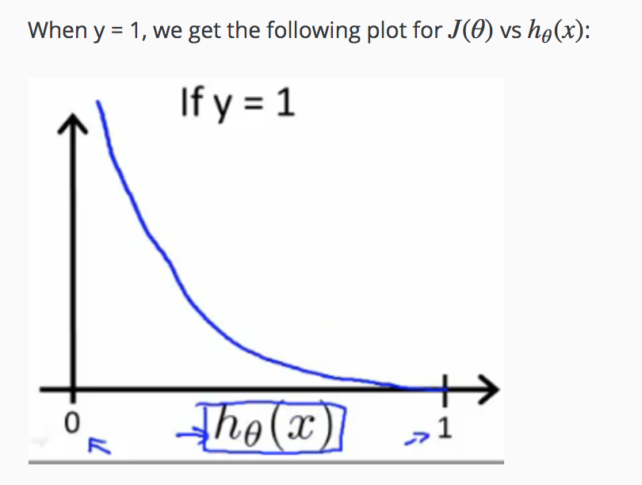
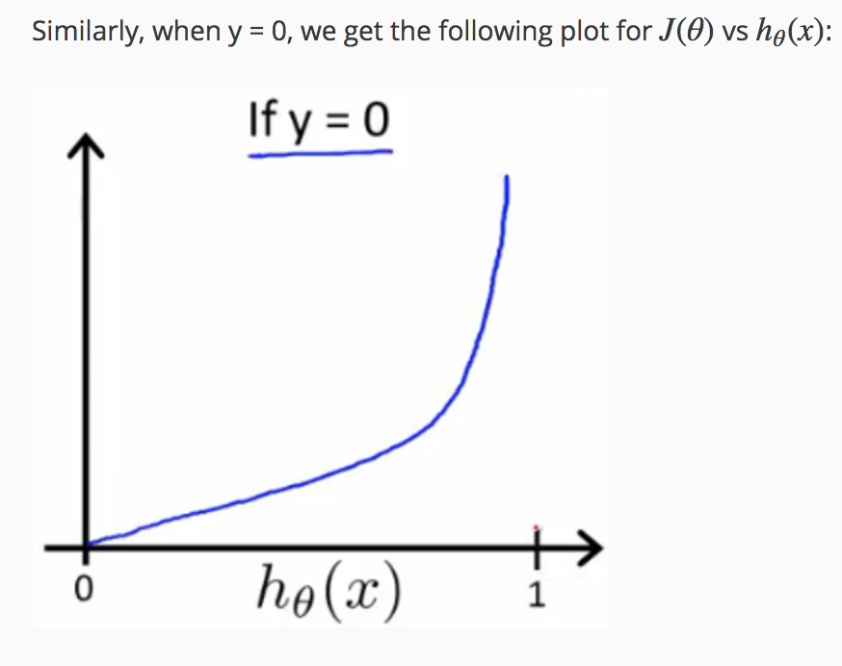
Logistic Regression – Cost Function
Notes:
Cannot use the same one as logistic regression due to non convex nature of the cost function,multiple local minimaz no single way for the gradient descent to converge. Cost(hθ(x),y)=0 if hθ(x)=yCost(hθ(x),y)→∞ if y=0andhθ(x)→1Cost(hθ(x),y)→∞ if y=1andhθ(x)→0

Slide 14
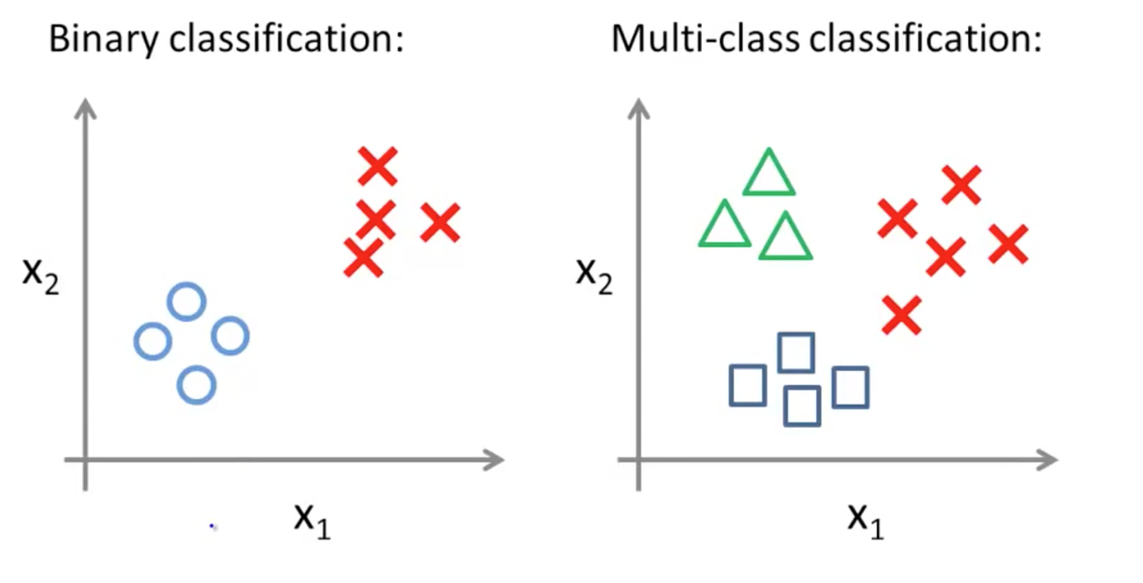
Binary vs Multi Class Classification
Notes:
Cannot use the same one as logistic regression due to non convex nature of the cost function,multiple local minimaz no single way for the gradient descent to converge. Cost(hθ(x),y)=0 if hθ(x)=yCost(hθ(x),y)→∞ if y=0andhθ(x)→1Cost(hθ(x),y)→∞ if y=1andhθ(x)→0

Slide 15
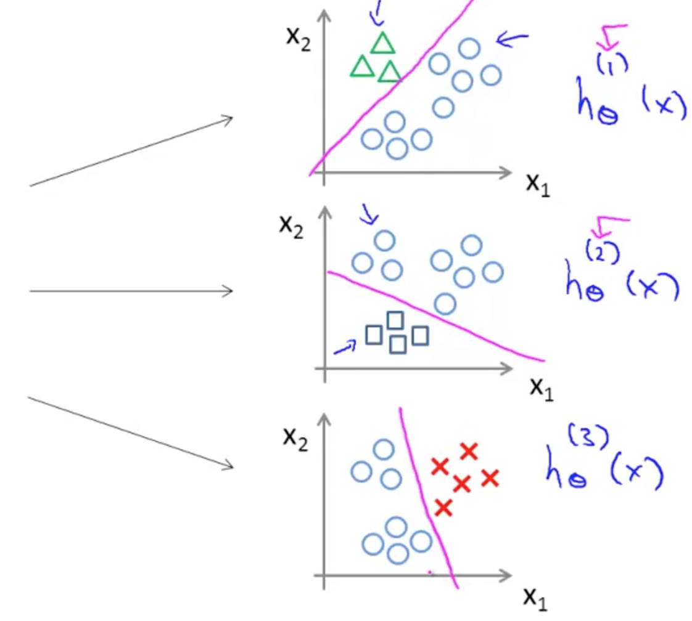
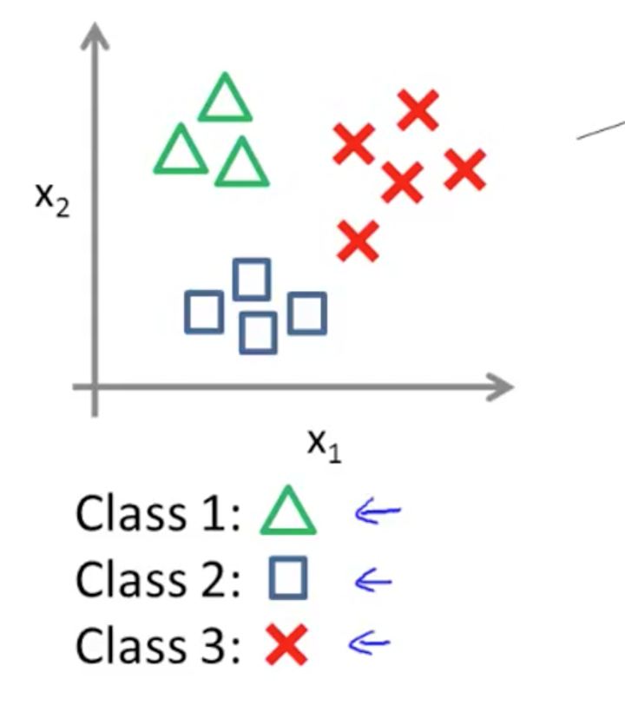
One vs all Classification
Notes:
Train a logistic regression classifier hθ(x) for each class￼ to predict the probability that ￼ ￼y = i￼ ￼.
To make a prediction on a new x, pick the class ￼that maximizes hθ(x)

Slide 16
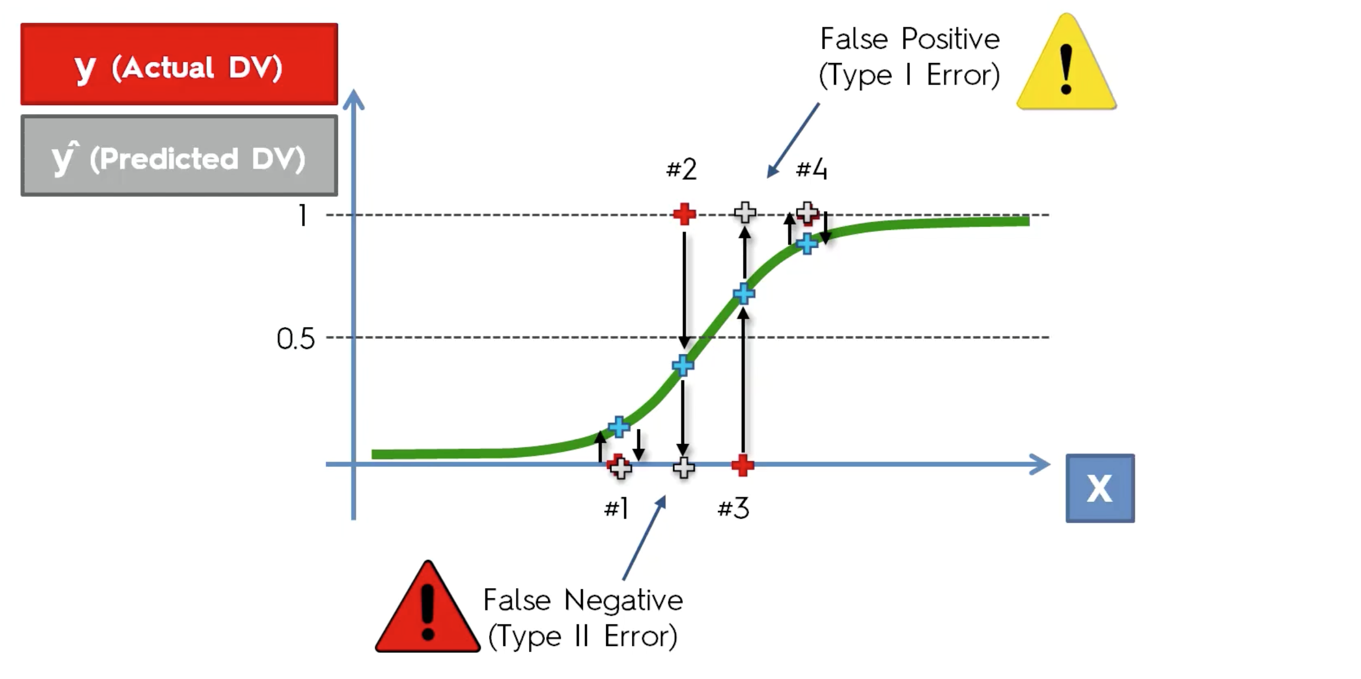
False Positive and False Negative
Notes:
In London

Slide 17
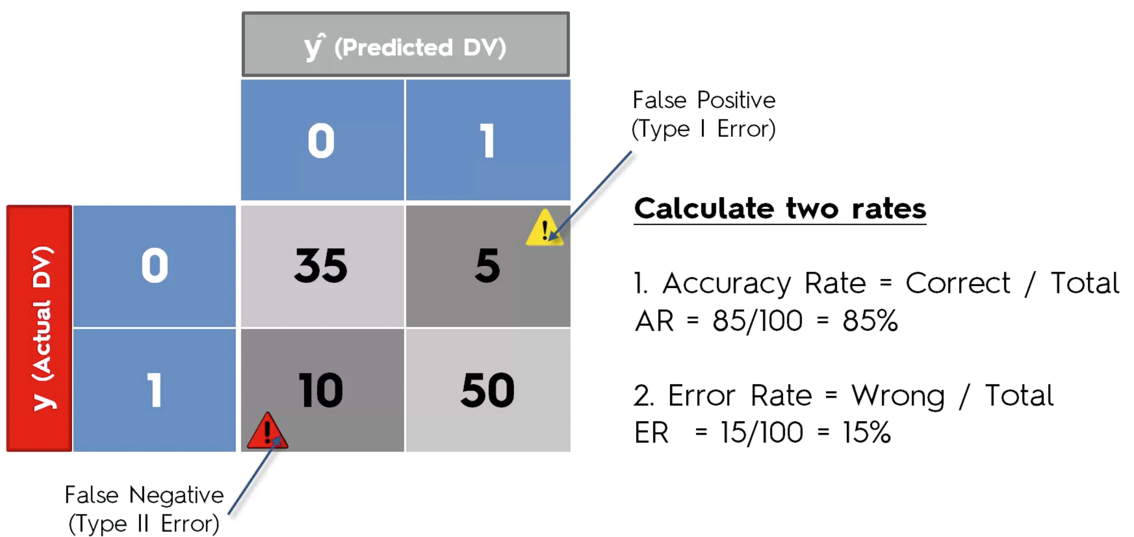
Evaluating Logistic Regression
Notes:
In London

Slide 18
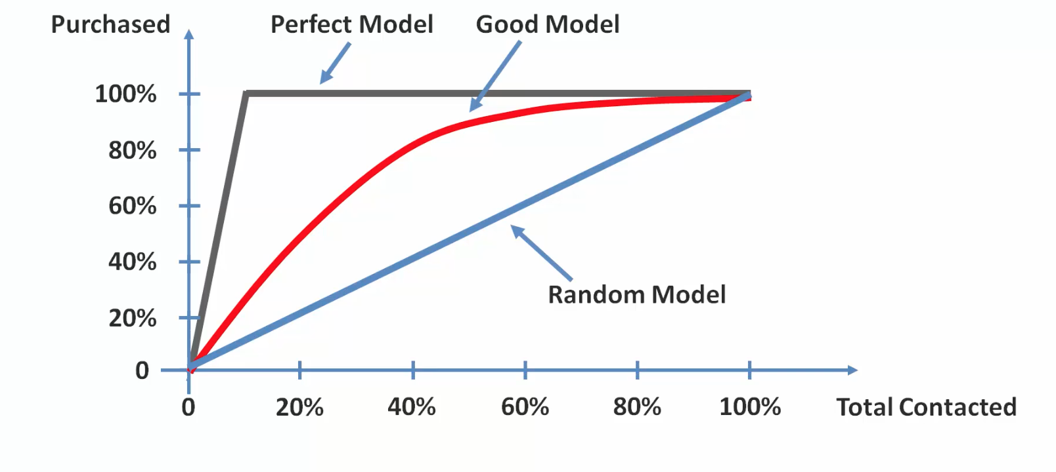
CAP Analysis
Notes:
Cumulative Accuracy Profile
Underlying graph – If we have send out emails to people regarding an offer,knowing that only 10% of people actually respond to such emails ,How do we create a better model so that we are able to achieve our targets as easily as possible

Slide 19
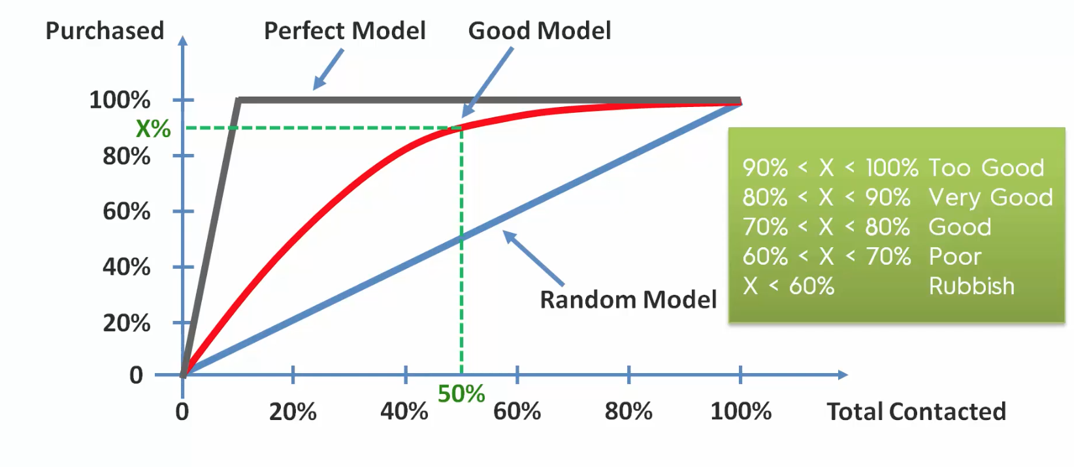
CAP Analysis
Notes:
Cumulative Accuracy Profile
Underlying graph – If we have send out emails to people regarding an offer,knowing that only 10% of people actually respond to such emails ,How do we create a better model so that we are able to achieve our targets as easily as possible

Slide 20
Application of Logistic Regression
Predict mortality in injured patients
Patient has a disease based on age,sex,BMI,blood reports etc
Predict customers propensity to buy a product
Conditional Random Fields an extension to logistic regression
Notes:
In London

Slide 21
Exercise
Notes:
In London

Slide 22
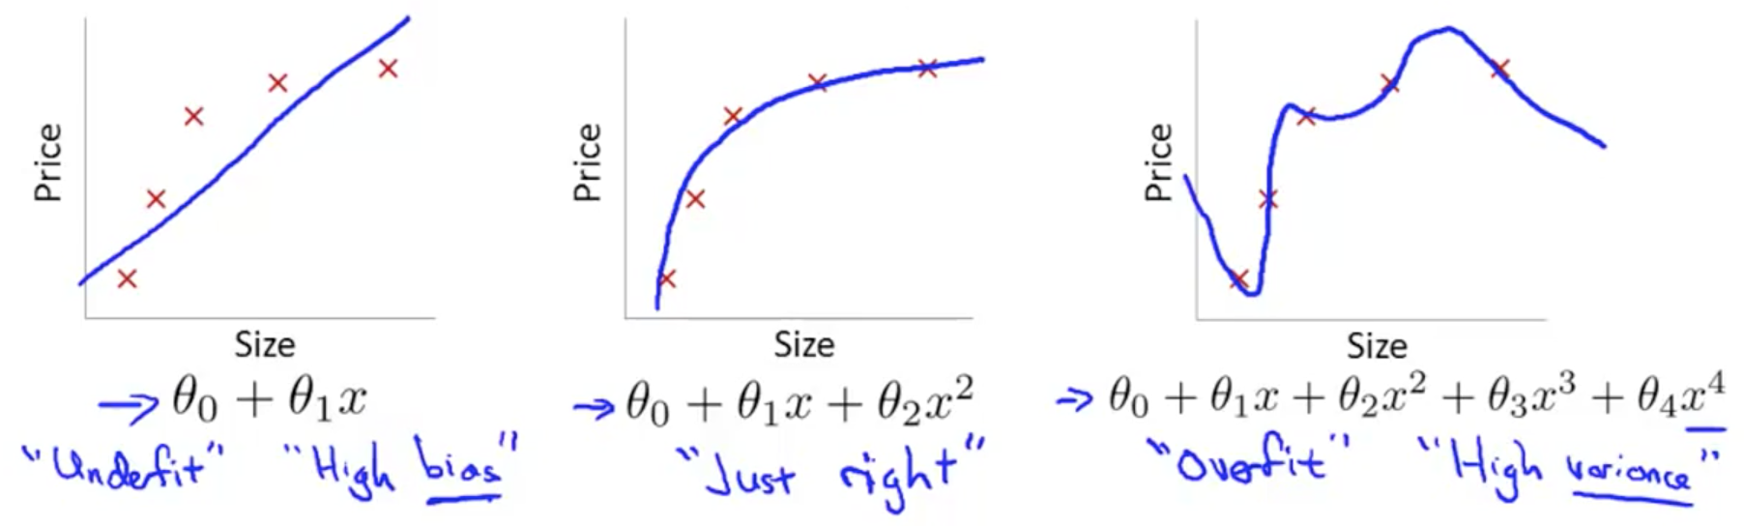
Solving the problem for overfitting
Overfitting : If we have too many features, the learned hypothesis may fit the training data very well but failed to generalize on new examples
Linear Regression
Notes:
In London

Slide 23
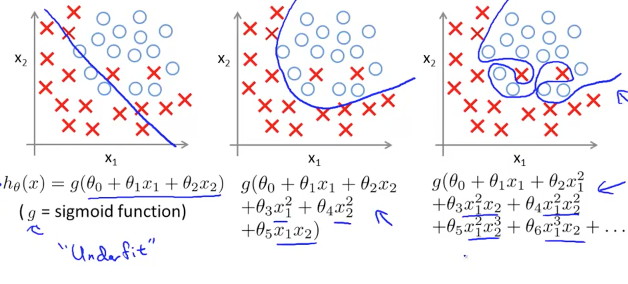
Logistic Regression
Notes:
In London

Slide 24
How to solve for overfitting?
- Reduce the number of features:
Manually select which features to keep.
Use a model selection algorithm
- Regularization
Keep all the features, but reduce the magnitude of parameters θj.
Regularization works well when we have a lot of slightly useful features
Notes:
In London

Slide 25
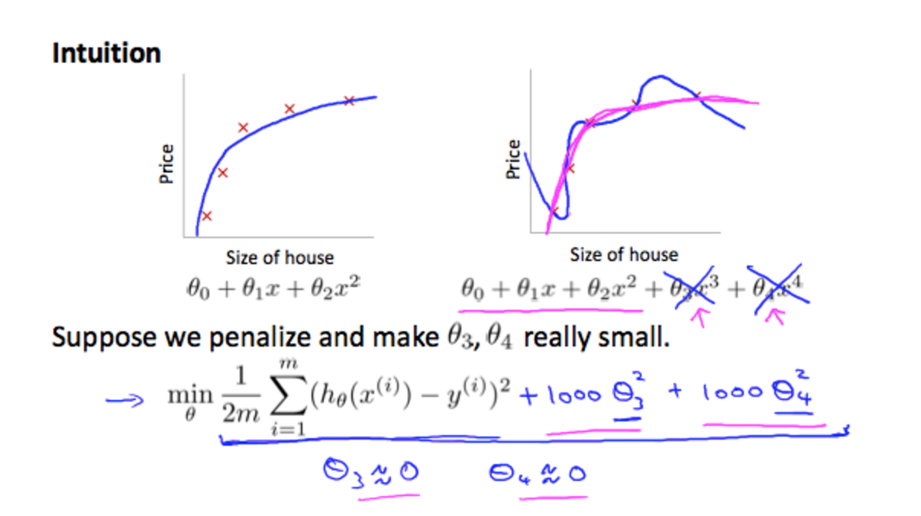
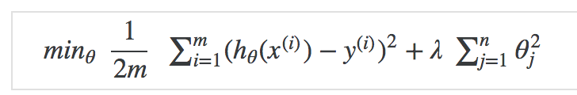
Regularization
The λ, or lambda, is the regularization parameter
Notes:
The λ, or lambda, is the regularization parameter. It determines how much the costs of our theta parameters are inflated.
Using the above cost function with the extra summation, we can smooth the output of our hypothesis function to reduce overfitting. If lambda is chosen to be too large, it may smooth out the function too much and cause underfitting. Hence, what would happen if λ=0 or is too small ?

Slide 26
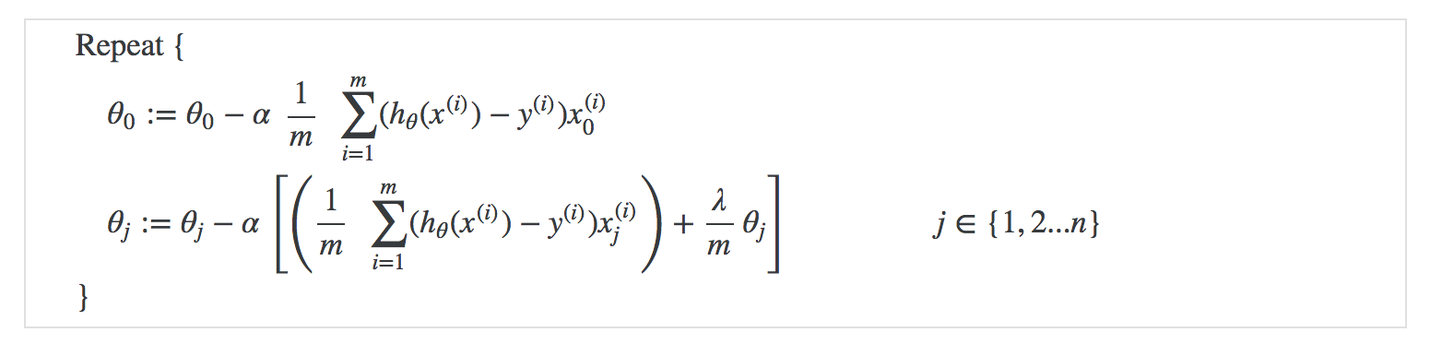
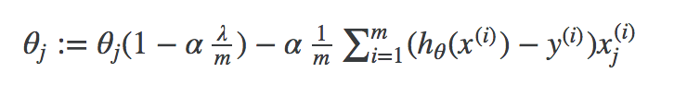
Regularization for linear regression
We will modify our gradient descent function to separate out θ0 from the rest of the parameters because we do not want to penalize θ0.
Notes:
The first term in the above equation, 1−αλm will always be less than 1. Intuitively you can see it as reducing the value of θj by some amount on every update. Notice that the second term is now exactly the same as it was before.

Slide 27
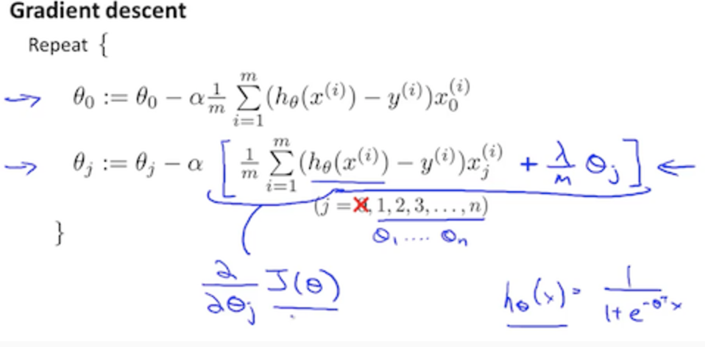
Regularization for logistic regression
Notes:
The second sum, ∑nj=1θ2j means to explicitly exclude the bias term, θ0. I.e. the θ vector is indexed from 0 to n (holding n+1 values, θ0 through θn), and this sum explicitly skips θ0, by running from 1 to n, skipping 0. Thus, when computing the equation, we should continuously update the two following equations:

Slide 28
Homework
What is model selection algorithm and how is it used in overfitting?
Load the myopia study and w.r.t SPHEQ(spherical equivalent refraction) predict whether the patient has myopia or not. Plot the scatter graph and visualize the logistic regression model

